Slide 1
Chat App
Huaishu Ge - 12694485
Thavorn KHANTHAVONG – 13088291
Tribhumi Vacharagasemsin - 12861732

Slide 2
Target Audience
Startups
A company who want to have their chat app.
Individually interest , specially students, developers
Notes:
For example, a company developed their own in-house application but it does not contain a chat feature.

Slide 3
Current stage of the app
Register User (with avatar)
Login
Logout
Show the list of users (separate by city or country)
Block user
Notes:
For example, a company developed their own in-house application but it does not contain a chat feature.

Slide 4
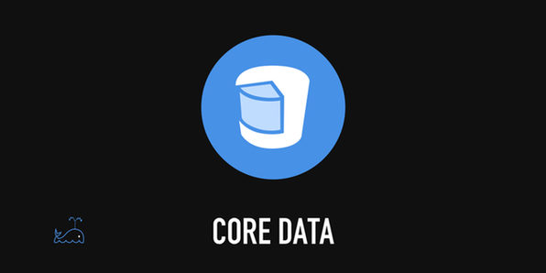

Frameworks
ProgressHUD
Notes:
We use 2 main frameworks in our app such as Firebase and Core Data.
We use Firebase to perform realtime CRUD operation with Google server and Core Data for local storage.

Slide 5
In the future
Text sending among users
Group chat
Photo sending
Videos
And share location,
Core ML

Slide 6
Q&A
Thank you

